Slide 1
Cloud Security and Privacy

Slide 2
Cloud Computing Background
Features
  Use of internet-based services to support business process
  Rent IT-services on a utility-like basis
Attributes
  Rapid deployment
  Low startup costs/ capital investments
  Costs based on usage or subscription
  Multi-tenant sharing of services/ resources
Essential characteristics
  On demand self-service
  Ubiquitous network access
  Location independent resource pooling
  Rapid elasticity
  Measured service
“Cloud computing is a compilation of existing techniques and technologies, packaged within a new infrastructure paradigm that offers improved scalability, elasticity, business agility, faster startup time, reduced management costs, and just-in-time availability of resources”
From NIST
Notes:
Government and Military sectors: complicated procurement rules and stringent security requirements
Cloud-based categories:
Cloud-based applications (SAAS)
Cloud-based development (e.g. Google App Engine)
Cloud-based infrastructure (e.g. Amazon’s EC2)

Slide 3
A Massive Concentration of Resources
Also a massive concentration of risk
  expected loss from a single breach can be significantly larger
  concentration of “users” represents a concentration of threats
“Ultimately, you can outsource responsibility but you can’t outsource accountability.”

Slide 4
Cloud Computing: who should use it?
Cloud computing definitely makes sense if your own security is weak, missing features, or below average.
Ultimately, if
  the cloud provider’s security people are “better” than yours (and leveraged at least as efficiently),
  the web-services interfaces don’t introduce too many new vulnerabilities, and
  the cloud provider aims at least as high as you do, at security goals,
then cloud computing has better security.

Slide 5
Cloud Models
Delivery Models
  SaaS
  PaaS
  IaaS
Deployment Models
  Private cloud
  Community cloud
  Public cloud
  Hybrid cloud
We propose one more Model: Management Models (trust and tenancy issues)
  Self-managed
  3rd party managed (e.g. public clouds and VPC)
From [1] NIST
Notes:
Trust and tenancy issues as well as loss of control related to the management model

Slide 6
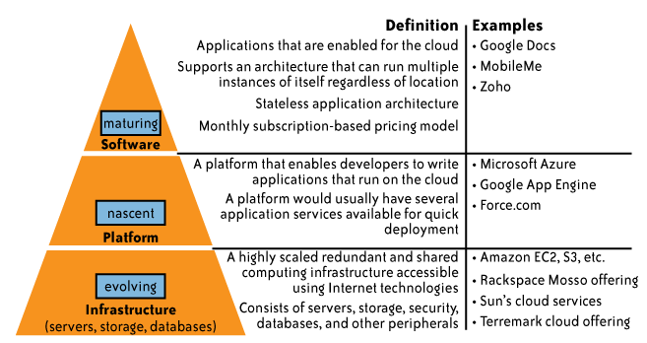
Delivery Models
While cloud-based software services are maturing,
Cloud platform and infrastructure offering are still in their early stages !

Slide 7
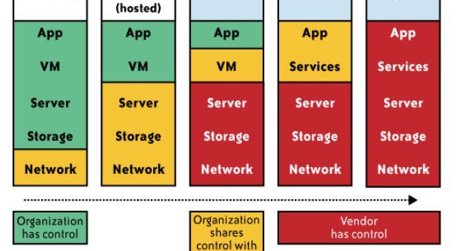
Impact of cloud computing on the governance structure of IT organizations

Slide 8
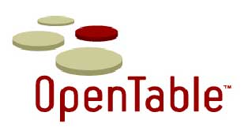






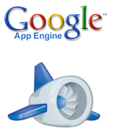


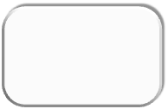




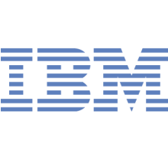





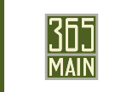





Cloud Services Stack
Application
Cloud Services
Platform
Cloud Services
Compute & Storage
Cloud Services
Co-Location
Cloud Services
Network
Cloud Services
Nov.8, 2010
Kai Hwang, USC

Slide 9
IF CLOUD COMPUTING IS SO GREAT,
WHY ISN’T EVERYONE DOING IT?
The cloud acts as a big black box, nothing inside the cloud is visible to the clients
Clients have no idea or control over what happens inside a cloud
Even if the cloud provider is honest, it can have malicious system admins who can tamper with the VMs and violate confidentiality and integrity
Clouds are still subject to traditional data confidentiality, integrity, availability, and privacy issues, plus some additional attacks

Slide 10
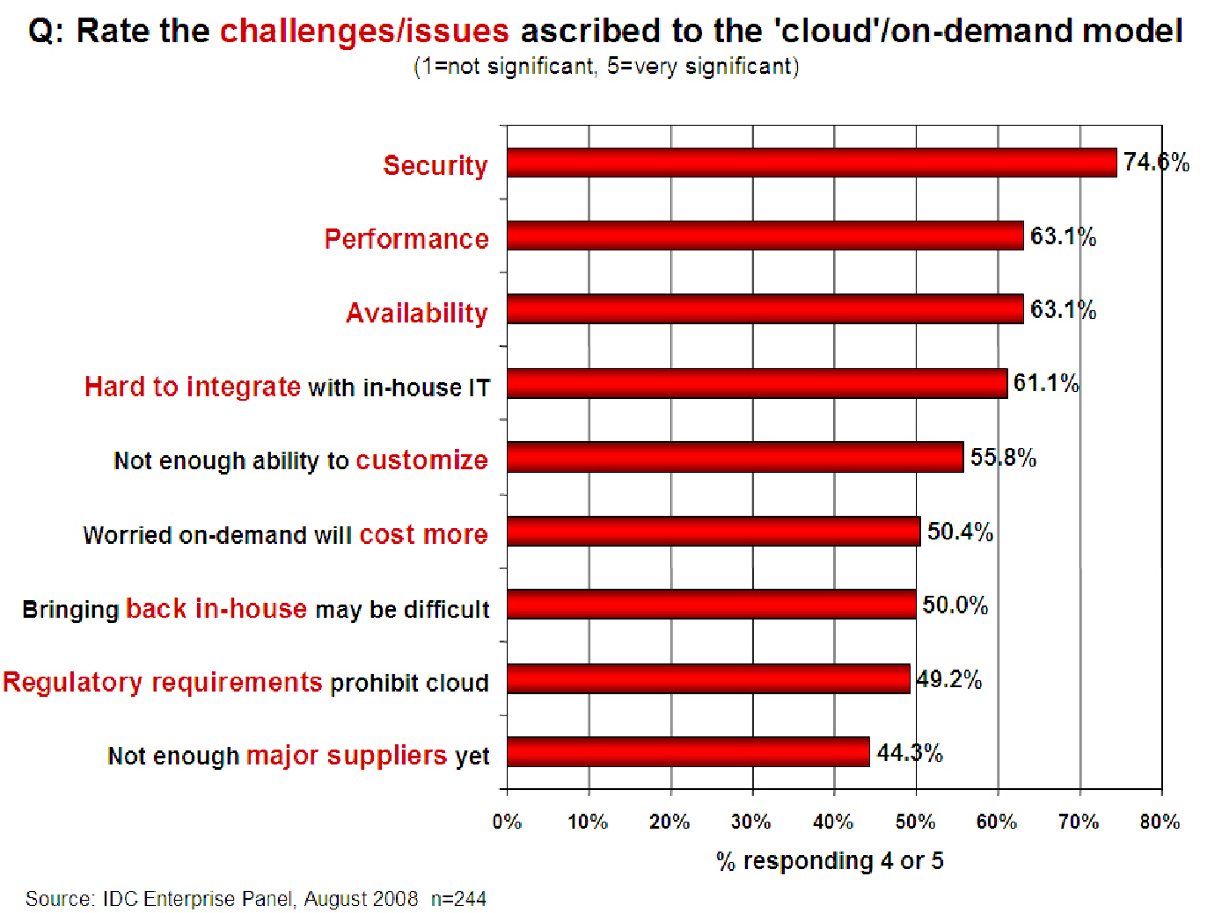
Companies are still afraid to use clouds
[Chow09ccsw]

Slide 11
Causes of Problems Associated with Cloud Computing
Most security problems stem from:
  Loss of control
  Lack of trust (mechanisms)
  Multi-tenancy
These problems exist mainly in 3rd party management models
  Self-managed clouds still have security issues, but not related to above
Notes:
Data mobility: the ability to share data between cloud services
Where does data reside?
- out-of-state, out-of-country issues
Security Concerns for government in particular
FISMA
How to certify and accredit cloud computing providers under FISMA
(e.g. ISO 27001)

Slide 12
Loss of Control in the Cloud
Consumer’s loss of control
  Data, applications, resources are located with provider
  User identity management is handled by the cloud
  User access control rules, security policies and enforcement are managed by the cloud provider
  Consumer relies on provider to ensure
    Data security and privacy
    Resource availability
    Monitoring and repairing of services/resources

Slide 13
Lack of Trust in the Cloud
  Trusting a third party requires taking risks
Defining trust and risk
  Opposite sides of the same coin (J. Camp)
  People only trust when it pays (Economist’s view)
  Need for trust arises only in risky situations
Defunct third party management schemes
  Hard to balance trust and risk
  e.g. Key Escrow (Clipper chip)
  Is the cloud headed toward the same path?
Notes:
Chiles and McMakin (1996) define trust as increasing one’s vulnerability to the risk of opportunistic behavior of another whose behavior is not under one’s control in a situation in which the costs of violating the trust are greater than the benefits of upholding the trust.
Trust here means mostly lack of accountability and verifiability

Slide 14
Multi-tenancy Issues in the Cloud
Conflict between tenants’ opposing goals
  Tenants share a pool of resources and have opposing goals
How does multi-tenancy deal with conflict of interest?
  Can tenants get along together and ‘play nicely’ ?
  If they can’t, can we isolate them?
How to provide separation between tenants?
Cloud Computing brings new threats
  Multiple independent users share the same physical infrastructure
  Thus an attacker can legitimately be in the same physical machine as the target
Notes:
Who are my neighbors? What is their objective? They present another facet of risk and trust requirements

Slide 15
Taxonomy of Fear
Confidentiality
  Fear of loss of control over data
    Will the sensitive data stored on a cloud remain confidential?
    Will cloud compromises leak confidential client data
  Will the cloud provider itself be honest and won’t peek into the data?
Integrity
  How do I know that the cloud provider is doing the computations correctly?
  How do I ensure that the cloud provider really stored my data without tampering with it?

Slide 16
Taxonomy of Fear (cont.)
Availability
  Will critical systems go down at the client, if the provider is attacked in a Denial of Service attack?
  What happens if cloud provider goes out of business?
  Would cloud scale well-enough?
  Often-voiced concern
    Although cloud providers argue their downtime compares well with cloud user’s own data centers

Slide 17
Taxonomy of Fear (cont.)
Privacy issues raised via massive data mining
  Cloud now stores data from a lot of clients, and can run data mining algorithms to get large amounts of information on clients
Increased attack surface
  Entity outside the organization now stores and computes data, and so
  Attackers can now target the communication link between cloud provider and client
  Cloud provider employees can be phished

Slide 18
Taxonomy of Fear (cont.)
Auditability and forensics (out of control of data)
  Difficult to audit data held outside organization in a cloud
  Forensics also made difficult since now clients don’t maintain data locally
Legal quagmire and transitive trust issues
  Who is responsible for complying with regulations?
    e.g., SOX, HIPAA, GLBA ?
  If cloud provider subcontracts to third party clouds, will the data still be secure?

Slide 19
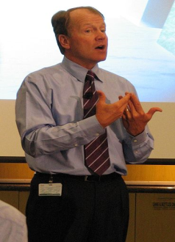
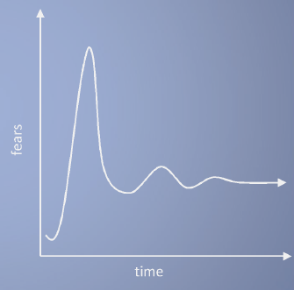
Taxonomy of Fear (cont.)
Cloud Computing is a security nightmare and it can't be handled in traditional ways.
John Chambers
CISCO CEO
Security is one of the most difficult task to implement in cloud computing.
  Different forms of attacks in the application side and in the hardware components
Attacks with catastrophic effects only needs one security flaw
(http://www.exforsys.com/tutorials/cloud-computing/cloud-computing-security.html)

Slide 20
Attacker Capability: Malicious Insiders
At client
  Learn passwords/authentication information
  Gain control of the VMs
At cloud provider
  Log client communication
  Can read unencrypted data
  Can possibly peek into VMs, or make copies of VMs
  Can monitor network communication, application patterns
  Why?
    Gain information about client data
    Gain information on client behavior
    Sell the information or use itself

Slide 21
Attacker Capability: Outside attacker
What?
  Listen to network traffic (passive)
  Insert malicious traffic (active)
  Probe cloud structure (active)
  Launch DoS
Goal?
  Intrusion
  Network analysis
  Man in the middle
  Cartography

Slide 22
Challenges for the attacker
How to find out where the target is located?
How to be co-located with the target in the same (physical) machine?
How to gather information about the target?

Slide 23
The Host Level
SaaS/PaaS
  Both the PaaS and SaaS platforms abstract and hide the host OS from end users
  Host security responsibilities are transferred to the CSP (Cloud Service Provider)
    You do not have to worry about protecting hosts
  However, as a customer, you still own the risk of managing information hosted in the cloud services.

Slide 24
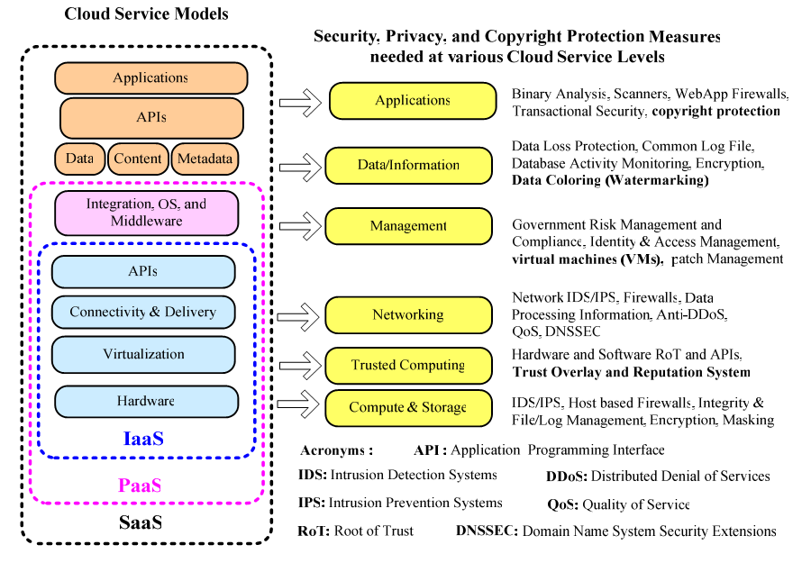
Cloud Service Models and Their Security Demands

Slide 25
Case study: Amazon's EC2 infrastructure
“Hey, You, Get Off of My Cloud: Exploring Information Leakage in Third-Party Compute Clouds”
  Multiple VMs of different organizations with virtual boundaries separating each VM can run within one physical server
  "virtual machines" still have internet protocol, or IP, addresses, visible to anyone within the cloud.
  VMs located on the same physical server tend to have IP addresses that are close to each other and are assigned at the same time
  An attacker can set up lots of his own virtual machines, look at their IP addresses, and figure out which one shares the same physical resources as an intended target
  Once the malicious virtual machine is placed on the same server as its target, it is possible to carefully monitor how access to resources fluctuates and thereby potentially glean sensitive information about the victim

Slide 26
Local Host Security
Are local host machines part of the cloud infrastructure?
  Outside the security perimeter
  While cloud consumers worry about the security on the cloud provider’s site, they may easily forget to harden their own machines
The lack of security of local devices can
  Provide a way for malicious services on the cloud to attack local networks through these terminal devices
  Compromise the cloud and its resources for other users
Notes:
The lack of security of local devices can disrupt the consumer and also provide a way for malicious services on the cloud to attack local networks through these terminal devices. In today’s ubiquitous computing environment, the local host machine may well be a desktop computer, a portable laptop or mobile device. While cloud consumers worry about the security on the cloud provider’s site, they may easily forget to harden their own machines. The lack of security of a local host can compromise the cloud and its resources for other users. With mobile devices, the threat may be even stronger, as users misplace or have the device stolen from them. The security mechanisms on handheld gadgets are often times insufficient compared to say, a desktop computer, providing a potential attacker an easy avenue into a cloud system. If a user relies mainly on a mobile device to access cloud data, the threat to availability is also increased as mobile devices malfunction or are lost.
Devices that access the cloud should have strong authentication mechanisms, should be tamper-resistant, and have cryptographic functionality when traffic confidentiality is required. Since this places a part of the security burden onto the consumer, the provider may need to stipulate in its policy or SLA. New approaches to mobile cloud computing in which applications lie in the cloud as opposed to on a smart phone, enable more sophisticated security mechanisms.
Users connect to the cloud from their local host machines.
In particular, many secure cloud data storing technologies require users to generate master keys (used to encrypt data or session keys) and store them on the local machine. If a malicious service in the cloud can tamper with the local machine and access these keys, confidentiality of data stored in the cloud is at risk.
For example, a user’s computer can be a zombie that can be used to attack the cloud. Or it can contain malicious code that damages provider-side resources, affecting not only the provider, but all its other consumers as well.
In today’s battle space, new technologies enable war fighters to use handheld devices to gather data for analysis at command centers. Therefore, the durability and robustness of these devices is a major concern not only for cloud computing but for general-purpose military use as well.
Memory curtaining techniques for sensitive areas of memories such as those places where keys are stored (i.e. provides isolation of sensitive memory areas). Remote attestation or TPM type requirements.

Slide 27
Local Host Security (Cont.)
With mobile devices, the threat may be even stronger
  Users misplace or have the device stolen from them
  Security mechanisms on handheld gadgets are often times insufficient compared to say, a desktop computer
  Provides a potential attacker an easy avenue into a cloud system.
  If a user relies mainly on a mobile device to access cloud data, the threat to availability is also increased as mobile devices malfunction or are lost
Devices that access the cloud should have
  Strong authentication mechanisms
  Tamper-resistant mechanisms
  Strong isolation between applications
  Methods to trust the OS
  Cryptographic functionality when traffic confidentiality is required

Slide 28
The Application Level
DoS
EDoS(Economic Denial of Sustainability)
  An attack against the billing model that underlies the cost of providing a service with the goal of bankrupting the service itself.
End user security
Who is responsible for Web application security in the cloud?
SaaS/PaaS/IaaS application security
Customer-deployed application security

Slide 29
Data Security and Storage
Several aspects of data security, including:
  Data-in-transit
    Confidentiality + integrity using secured protocol
    Confidentiality with non-secured protocol and encryption
  Data-at-rest
    Generally, not encrypted , since data is commingled with other users’ data
    Encryption if it is not associated with applications?
      But how about indexing and searching?
      Then homomorphic encryption vs. predicate encryption?
  Processing of data, including multitenancy
    For any application to process data, not encrypted

Slide 30
Data Security and Storage (cont.)
  Data lineage
    Knowing when and where the data was located w/i cloud is important for audit/compliance purposes
    e.g., Amazon AWS
      Store <d1, t1, ex1.s3.amazonaws.com>
      Process <d2, t2, ec2.compute2.amazonaws.com>
      Restore <d3, t3, ex2.s3.amazonaws.com>
  Data provenance
    Computational accuracy (as well as data integrity)
    E.g., financial calculation: sum ((((2*3)*4)/6) -2) = $2.00 ?
      Correct : assuming US dollar
      How about dollars of different countries?
      Correct exchange rate?
Where is (or was) that system located?
What was the state of that physical system?
How would a customer or auditor verify that info?

Slide 31
Data Security and Storage
  Data remanence
  Inadvertent disclosure of sensitive information is possible
Data security mitigation?
  Do not place any sensitive data in a public cloud
  Encrypted data is placed into the cloud?
Provider data and its security: storage
  To the extent that quantities of data from many companies are centralized, this collection can become an attractive target for criminals
  Moreover, the physical security of the data center and the trustworthiness of system administrators take on new importance.

Slide 32
What is Privacy?
The concept of privacy varies widely among (and sometimes within) countries, cultures, and jurisdictions.
It is shaped by public expectations and legal interpretations; as such, a concise definition is elusive if not impossible.
Privacy rights or obligations are related to the collection, use, disclosure, storage, and destruction of personal data (or Personally Identifiable Information—PII).
At the end of the day, privacy is about the accountability of organizations to data subjects, as well as the transparency to an organization’s practice around personal information.

Slide 33
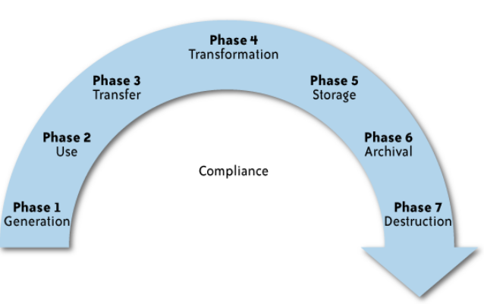
What is the data life cycle?
Personal information should be managed as part of the data used by the organization
Protection of personal information should consider the impact of the cloud on each phase

Slide 34
What Are the Key Privacy Concerns?
Typically mix security and privacy
Some considerations to be aware of:
  Storage
  Retention
  Destruction
  Auditing, monitoring and risk management
  Privacy breaches
  Who is responsible for protecting privacy?

Slide 35
Who is responsible for protecting privacy?
e.g., Suppose a hacker breaks into Cloud Provider A and steals data from Company X.
Assume that the compromised server also contained data from Companies Y and Z.
Who investigates this crime?
Is it the Cloud Provider, even though Company X may fear that
the provider will try to absolve itself from responsibility?
Is it Company X and, if so, does it have the right to see other data on that server,
including logs that may show access to the data of Companies Y and Z?
Data breaches have a cascading effect
Full reliance on a third party to protect personal data?
In-depth understanding of responsible data stewardship
Organizations can transfer liability, but not accountability
Risk assessment and mitigation throughout the data life cycle is critical.
Many new risks and unknowns
  The overall complexity of privacy protection in the cloud represents a bigger challenge.

Slide 36
Questions?

